Slide 1
English - Creative Writing
Year 9 and/or 10

Slide 2
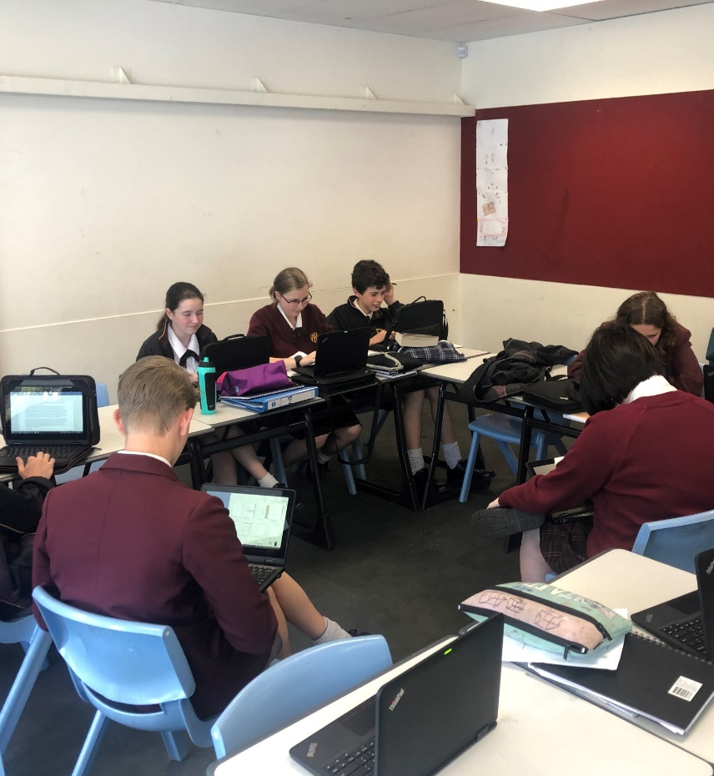
CREATIVE WRITING
The Creative Writing elective gives budding writers the opportunity to hone their skills.
Students will learn to use the power of the language to convey ideas, thoughts and feelings in a variety of genres including:
Poetic
Descriptive
Persuasive
Narrative
Expository

Slide 3

Writers are Readers
Learners investigate texts and create their own, producing a folio of original work. Emphasis is given to developing skills in crafting writing, both through workshop processes and through investigation of other writers' approaches. As part of their study, learners undertake personal reading which is designed to support and extend their work. Students will reflect on their own writing and experiment with styles, vocabulary and literary techniques.

Slide 4
Writing Extension Opportunities
This is a wonderful opportunity for students to enhance their skills in writing and higher order thinking.
Throughout this course, students may be participating in writing competitions and will be as submitting pieces for external online publications. These include school publications such as the Dominic College Newsletter, Yearbook and Website as well as class blogs and podcasts.
Pathways include careers in journalism, law, marketing, foreign affairs, education, tourism and policy writing.

Slide 5
FIND OUT MORE
Please contact Janet Marcenko, Coordinator of English, at jmarcenko@dominic.tas.edu.au

